Slide 1
Bank Marketing Analysis- For Term Deposits

Slide 2
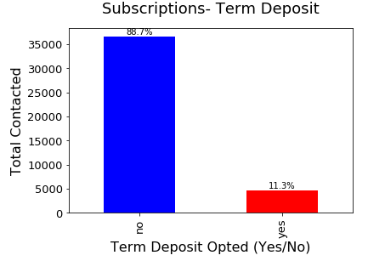
BANK Marketing Term Deposits - ANALYSIS
Bank marketing dataset has data for 41188 users with 20 features describing the final predictant which concludes user’s subscription to Term Deposit plan
11.3% of people turned to be positive and made a subscribed the Term Deposit
Some features in the data describes the client’s personal data and some other attributes describes the behaviour pattern of the client
An attempt made to analyze the past behaviour and accommodated the observations and suggestions.
This is a predictive classification problem to determine a client will subscribe the Term Deposits based on the client’s data and attributes. We have used the classic Logistic Regression and Random Forest Classifier by adding cross validation, regularization techniques

Slide 3
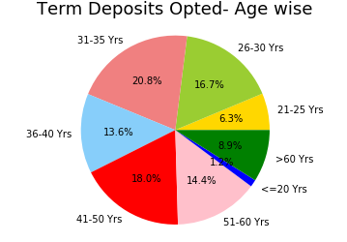
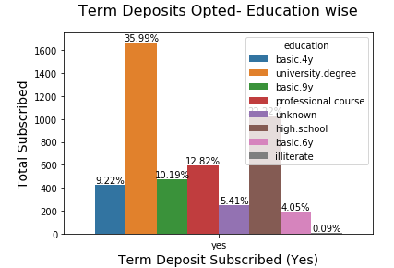
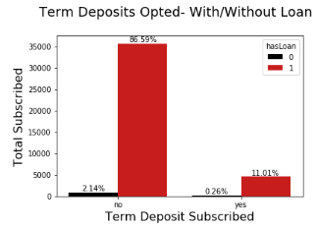
Observations/Suggestions- Based on Age, Education, Loan status
Age:
Observation: Around 38% of people from the age groups 26 years to 35 years have shown much interests for opting the Term Deposits compared to the people from the other age Groups
Education:
Observation: Educated people with a university degree are opting for the Term Deposits. In this we see that around 35.99% have opted which is much more compared to the people from the other education background
Loan Status:
Observation: From the total group of population, 11.01% have opted for Term Deposit. This shows that people are interested in making a short term investment, irrespective of their loan status
Suggestions:
Work on a strategy like giving more offers, benefits, gift cards to the users who opt for Term Deposit. As we see more subscriptions from the youngsters who should be in the stage of saving through many investments. Offering more benefits would play an attraction factor among young people

Slide 4
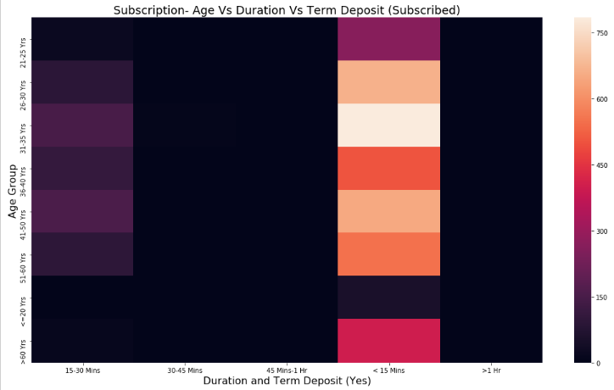
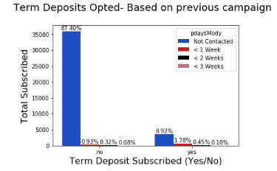
Observations/Suggestions- Based on Contact Duration, Previous Campaign
Contact Duration:
Observation:
This shows that most people are able to make a decision and opt Term Deposit in a shorter time less than 15 minutes of convincing attempted by the marketing person
Previous Campaign:
Observation:
From the total data, majority of the people i.e. around 8.92% who opt for Term Deposit made their decision of opting Term Deposits in the first attempt of the call made to the user
Suggestions:
It is only the first call that acts as a decision factor for most people in a short call duration.
Marketing people should try to make a good impression in the first call. Working towards communication strategies, well planned agenda before making the call, stop asking the questions that makes the user less interests in the call should be taken as factors for improvements from next campaign.

Slide 5
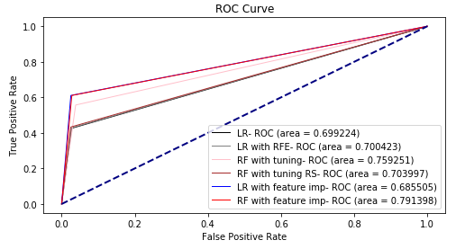
Model building - observations
Models Used: Logistic Regression, Random Forest Classifier are the two models used for testing the predictions
Model Validation: Model accuracies are compared and validated using Cross validation techniques and Regularisation techniques using Randomized Search CV
Metrices- accuracy score, confusion matrix, classification report are also captured for better comparison
ROC Curve of the models are captured at different stages and compared with each other in a graph (ref here)
Validated the prediction by using RFE (Recursive Feature Elimination) and Feature Importance using the Random Forest Classifier
The best spot is captured with maximum accuracy using 23 features and Random Forest Classifier is implemented with those 23 features

Slide 6
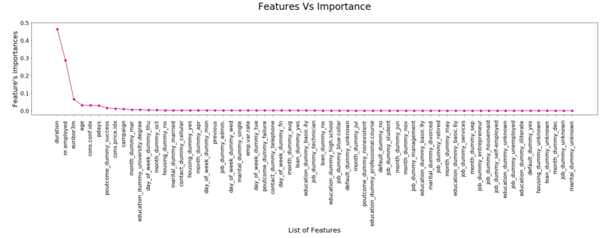
Model Building Observations
Feature Importance:
After implementing the models logistic regression, random forest classifier with model tuning techniques, best accuracy score is obtained using Random Forest Classifier
Also, from the feature importance graph, feature- duration has got more contribution towards the predictant variable and as highlighted in the previous slide, strategies should be identified on how to attract clients in a short time during the call
23 features are selected for the model implementation based on the importance mapping below

